Slide 1

AcuCycle
By: Team 9

Slide 2
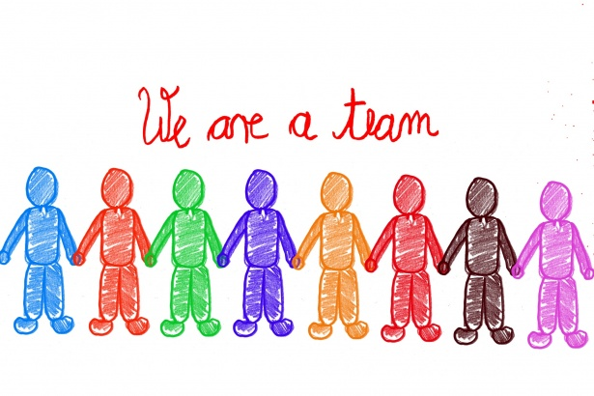
Our Team
Evan Templin - Developer - Crestwood
Phil Marotta - CPA Business Analyst - DSD Business
Leonardo Justiniano - Sr ERP Developer - The Answer Company
Vlad Sushkin - Technical Sales - Acumatica
Eulogio Castro - Data Engineer- Avante Health Solutions
Greg Lang - Director of Operations and Systems - Progressive Group
Stan Sugden - CFO- Consolidated Resource, LLC
Scott Stanaland - IT Manager - Charlotte Avante Health Solutions
Notes:
Here’s our team!

Slide 3

What is an environmental impact?
Notes:
Scope 1 - Direct Emissions, fuel in company vehicles, natural gas to heat offices
Scope 2 - Purchased Electricity (Biggest)
Scope 3 - Corporate Business Travel, Extracting Raw Materials, Shipping and Transporting
Team 3 touched on scopes.
Team 5 touched on identifying the issue.
Carbon footprints
Vlad

Slide 4
Our Sustainable Project
We’re going to talk about 3 points:
Waste Management & Recycling
Bin Capacity
How AcuCycle tackles Sustainability
Notes:
Greg Lang - Introduces AcuCycle and our talking points

Slide 5
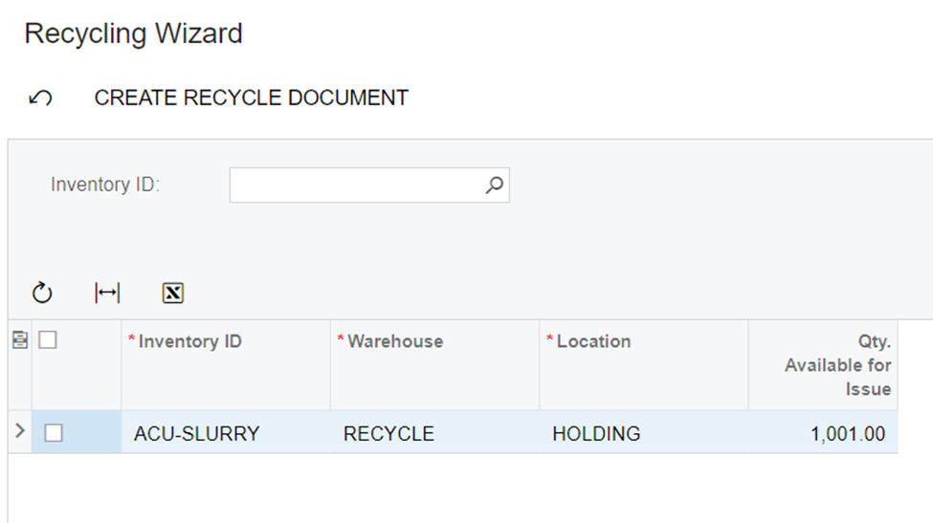
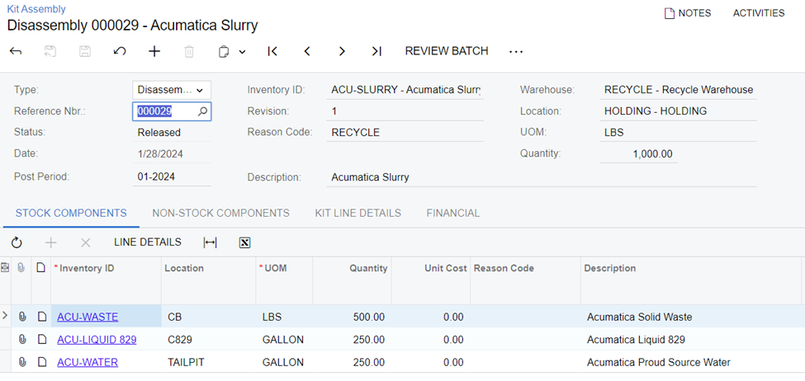
Waste Management & Recycling
We’ve created a new workspace called “AcuCycle” that:
-Automates and streamlines the process of managing recyclable materials
-Managing, tracking and processing Bin Capacity
-Reduces overhead and transactional volume in Acumatica
Notes:
Evan - Wizard
Leonardo - Bin Capacity

Slide 6
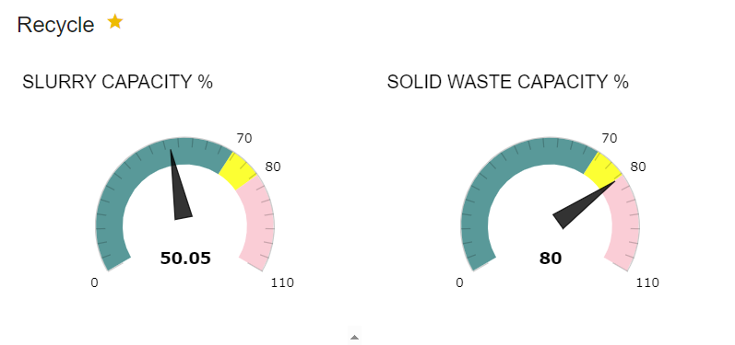
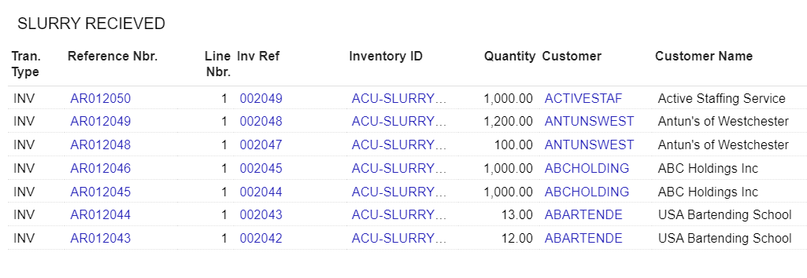
Bin Capacity
To accurately measure recyclable material, we’ve created a new metric / customization called Bin Capacity.
Unit of Measure x Quantity = Bin Capacity
Disposable Tons, Weight In / Out, Hazardous Material
Notes:
Phillip - Technical, Widgets, Major Components (Slurry is our example) Transactions completed, Drill-down capabilities. Process screens and capacities.
Greg - Sales Points

Slide 7
~25.3%*
United States Environmental Protection Agency stated that in 2022, the United States as a whole only recycled about 67.2 million tons of a possible 267.8 million tons. AcuCycle aims to increase the amount of recycled items by making an easy way for companies to implement Recycling workflows.
*Potential average time savings if this customization is implemented based on Acumatica transactional volume.
Notes:
Most environmental calculators are put behind a paywall. We measure this percentage through transactional volume reduced after implementation of this customization.
Less Energy
Reducing our Carbon Foot Print
Vlad

Slide 8

Sustainability
How our team carefully handled this idea
Notes:
Talk about the transparency of sustainability and recycling
Informational vs actual change.
Recycling is easy to talk about, sustainability is actually quite tough to implement.
Stan - Real world example

Slide 9
Measure, Reduce, Recycle
What’s Next?
Recycle, Refurbish, Waste
Custom Workflows
Item Classification
Native Module Extensions
Savings vs Waste
Wasteful Items
Items Creating Income
Notes:
We’re driving this point home. Future of this customization / project
Additional Workflows
Automation around Item Classification
Evan

Slide 10

Q&A
Team 9 - AcuCycle
Thank You!

